Slide 1
CLOUD STORAGE

Slide 2
Quick Survey
Does anyone have a lot of files on their computer but dosen’t have the space to store them?
Do you worry about losing files?
Do you want your files to be secure and easily accessible?

Slide 3

CLOUD STORAGE
Online file storage centers or cloud storage providers allow you to safely upload your files to the Internet.

Slide 4
Cloud Providers
There are various providers of cloud storage
Examples:
Apple iCloud
Dropbox
Google Drive
Amazon Cloud Drive
Microsoft SkyDrive

Slide 5
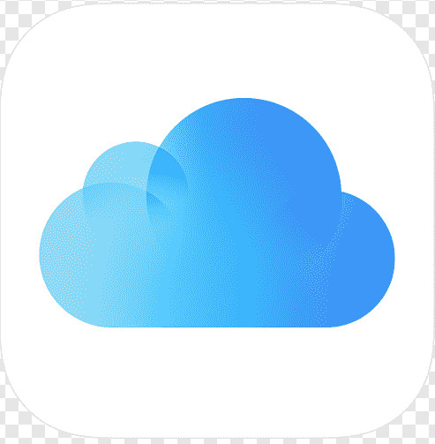
Apple iCloud
Gives 5GB of free storage (if you want more, you have to pay for it yearly)
Allows you to sync all your idevices to iCloud
Anything you have stored in the iCloud can be accessed from any idevice
For example, a document typed on an iPad and saved to the iCloud can be accessed from an iPhone.

Slide 6

Dropbox
Gives you 2GB of free storage
Allows you to get more free space by completing certain tasks
Available in the App Store and Android Market
For example, a file uploaded to Dropbox from a MacBook can be accessed from a Samsung phone.

Slide 7
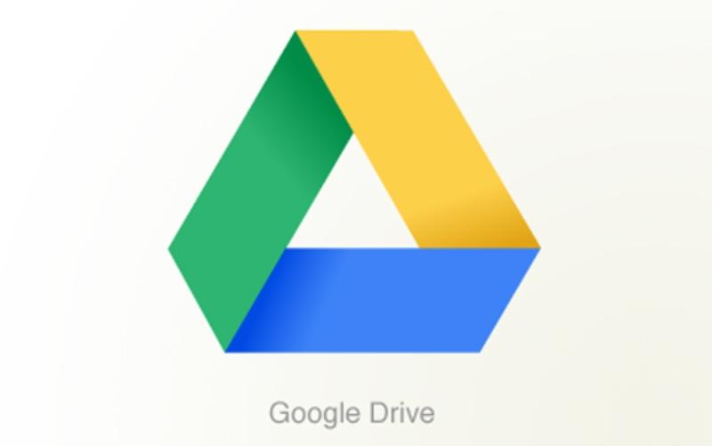
Google Drive
Gives you 15GB of free storage
Requires a G-mail account to be accessed
Individuals can buy more storage for themselves (Google Apps for Business Administrators can buy storage licenses)
Allows you to type documents, make spreadsheets/presentations, etc., and then save them to your drive.

Slide 8

Amazon Cloud Drive
Gives you 5GB of free storage (additional storage is available for $10 a year)
Available for download on Kindle Fire(HD)
A Save to CloudDrive app is available in the App Store for $1.99 and an Amazon Cloud Pictures is in the Android Market for free.

Slide 9

Microsoft SkyDrive
Gives you 7GB of free storage (additional storage can be bought)
Requires a Windows Live account to be accessed
Can be saved to a Windows computer as a mapped drive.

Slide 10
Which One Should I Pick?
The cloud provider you pick should fulfill all your needs as the consumer
If you need a lot of space, choose a provider that allows you to get the space you need
If you don’t need a lot of space, choose a provider that you can use for storing files that don’t take up a lot of space.

